Slide 1


IoT based Gas Leakage Detection System
PROJECT MEMBERS
❖ DHARNISH B M (23ITR029)
❖ ARUN S (23ITR007)
❖ DEEPIKA B (23ITR022)
PROJECT GUIDE
Ms. R. SANDHIYA

Slide 2




Problem Description
LPG (Liquefied Petroleum Gas) is commonly used in households and industries for cooking and heating.
Accidental gas leaks can occur due to faulty pipes, regulators, or valves.
Undetected leakages can lead to explosions, fire hazards, or even poisoning, posing a serious threat to human life and property.
These leakages are often undetected until the gas concentration reaches dangerous levels, potentially leading to explosions, fire hazards, or poisoning.

Slide 3
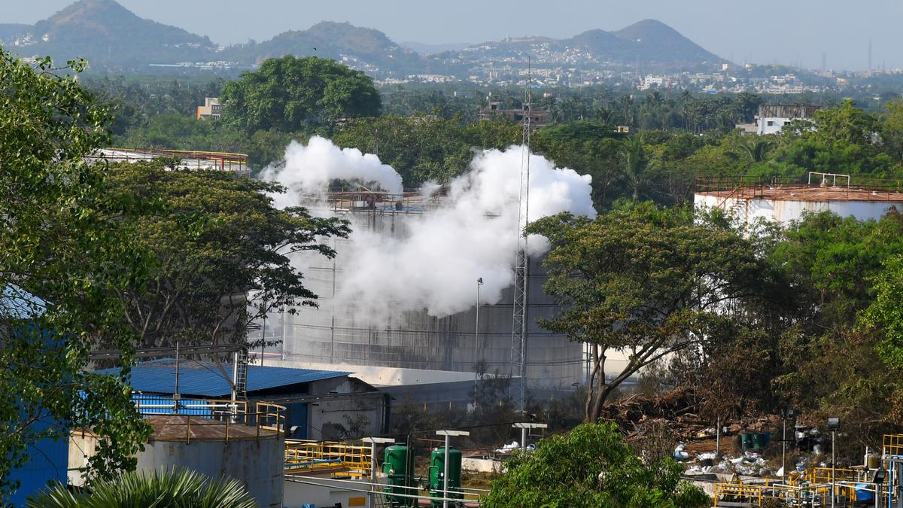
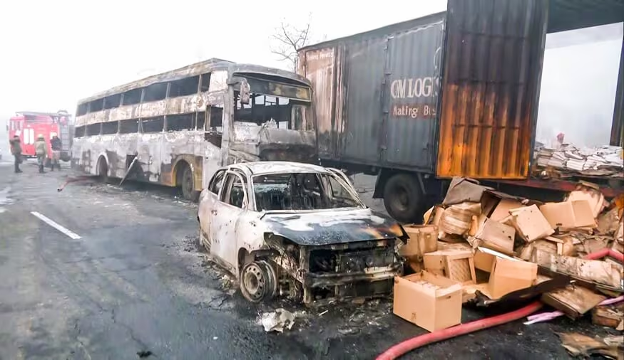
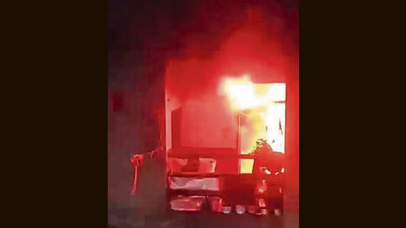
Accidents caused by Gas Leakage
Number of gas leak incidents rose to 30 ; maximum in Gujarat
Gas Leak, Then Blast: CCTV Shows Moments After Jaipur Crash That Killed 11
Gas leak triggers fire in Delhi house: 6 people jump for safety, including 2 women and a minor; all hospitalised

Slide 4

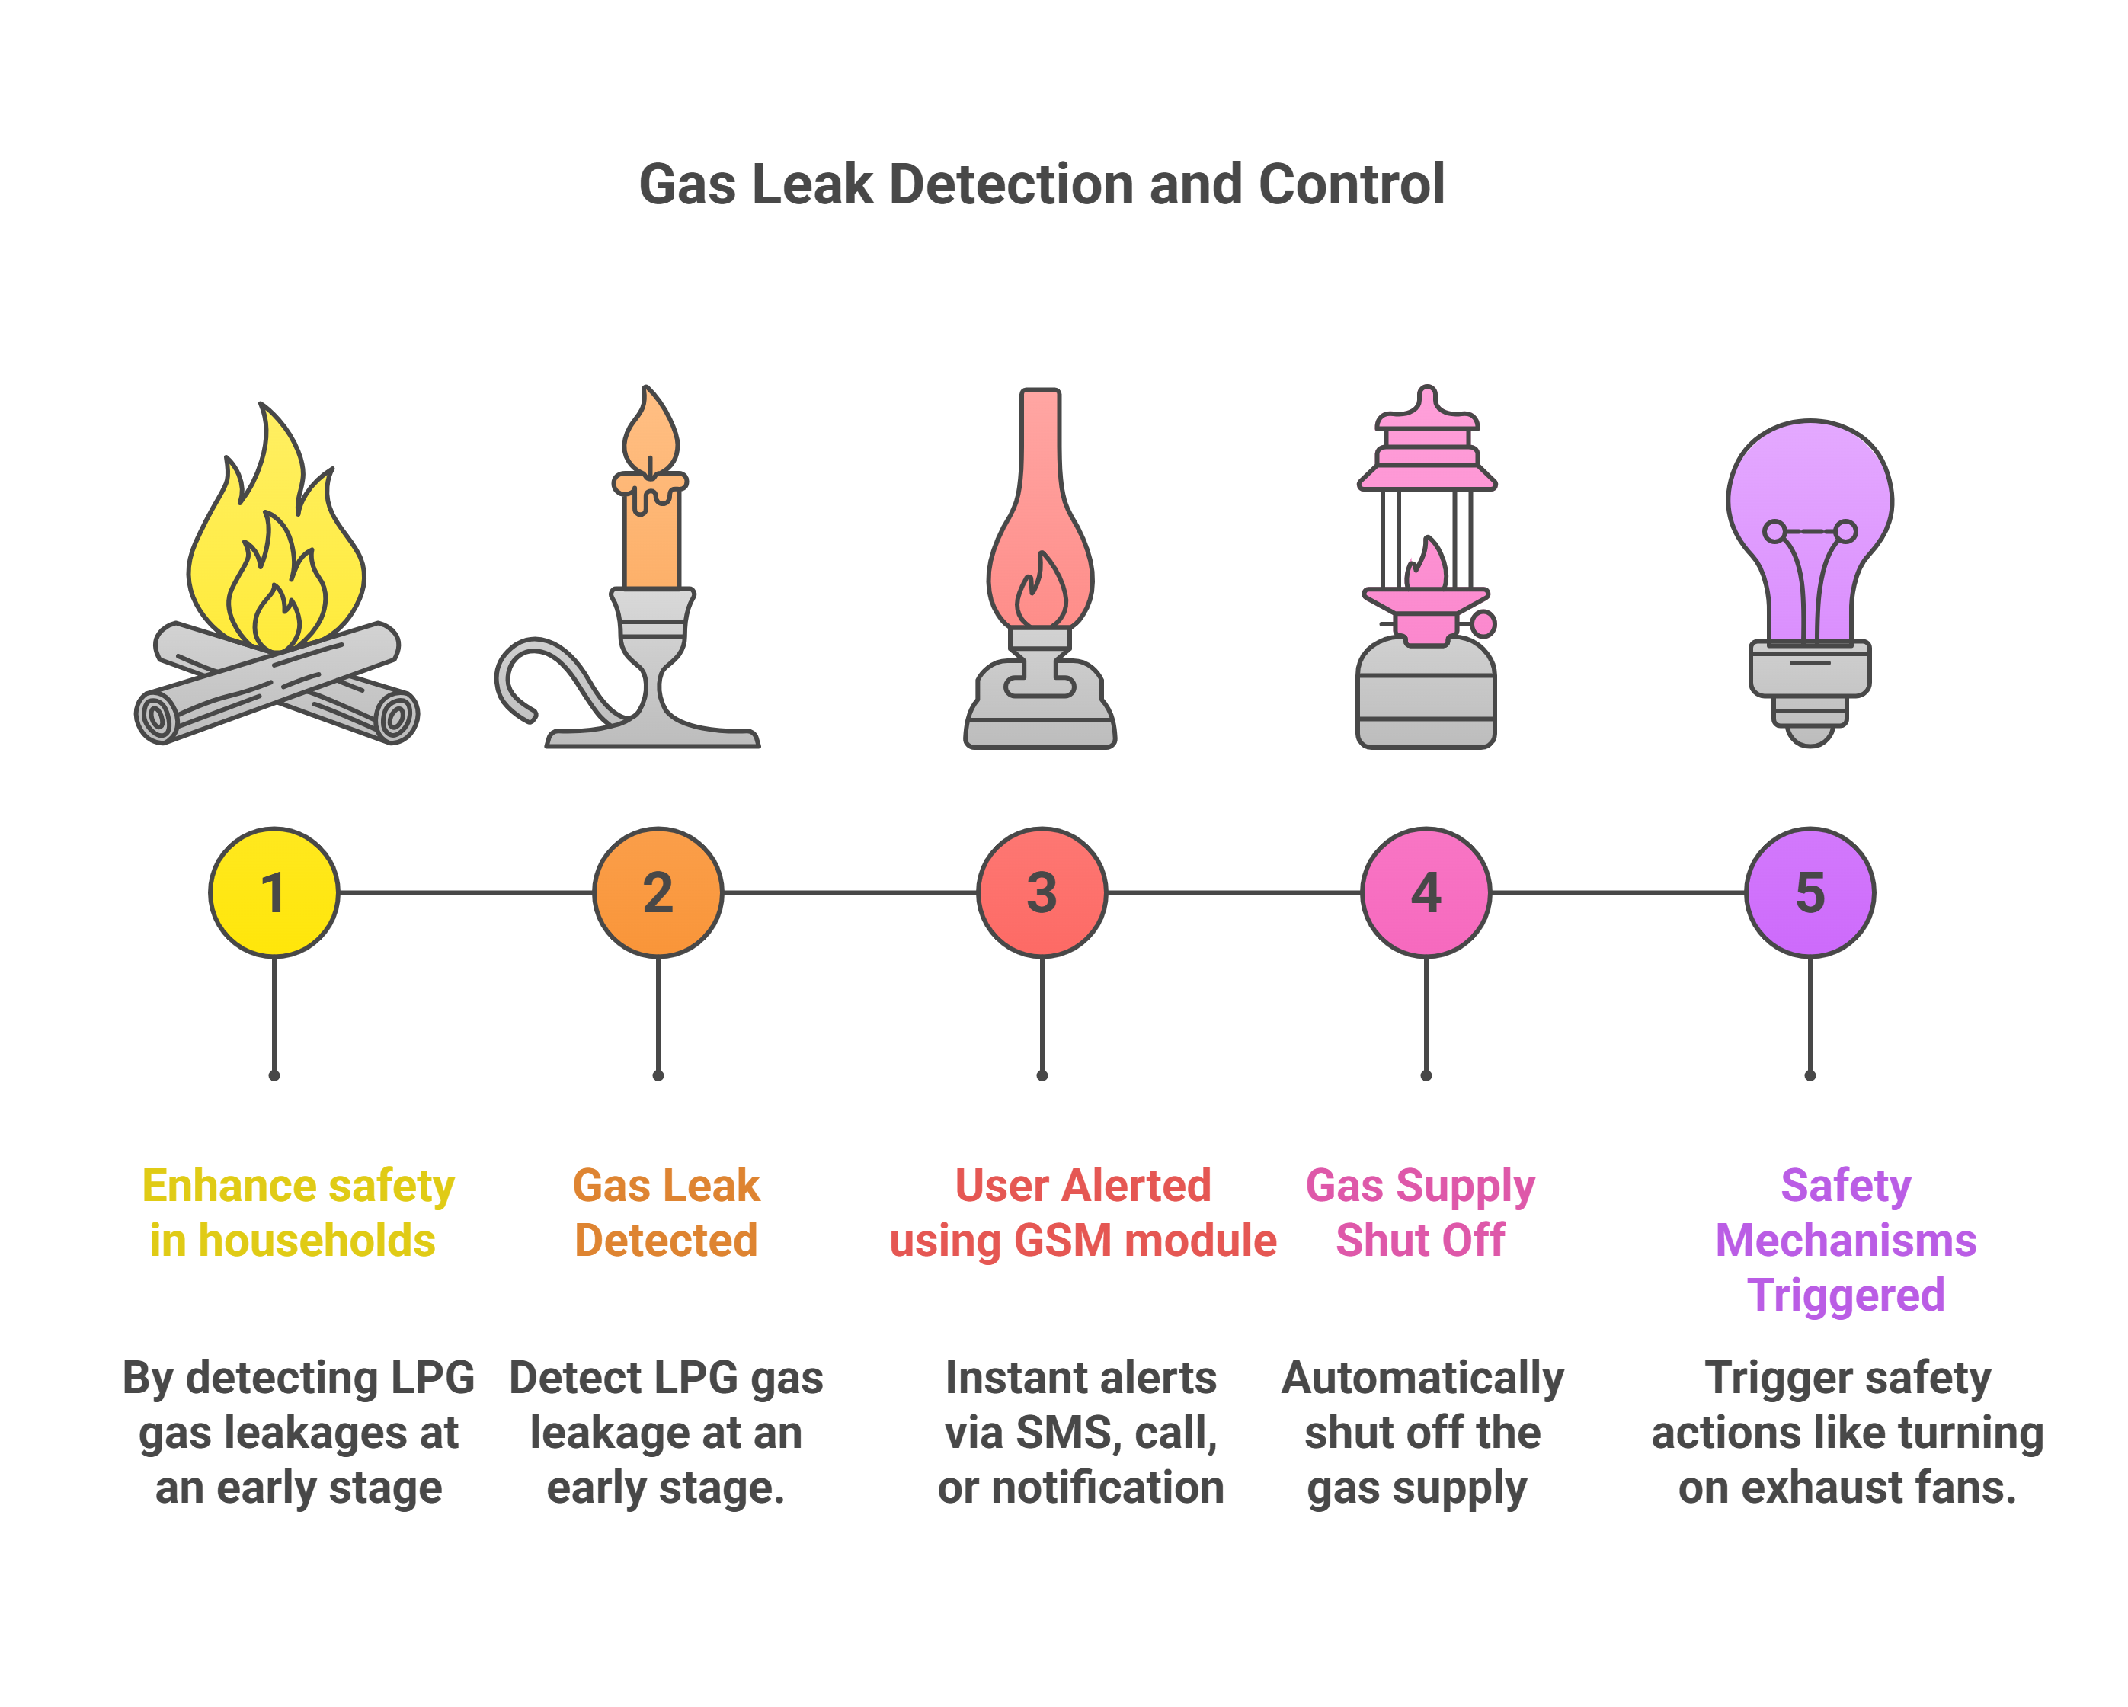
Objectives

Slide 5
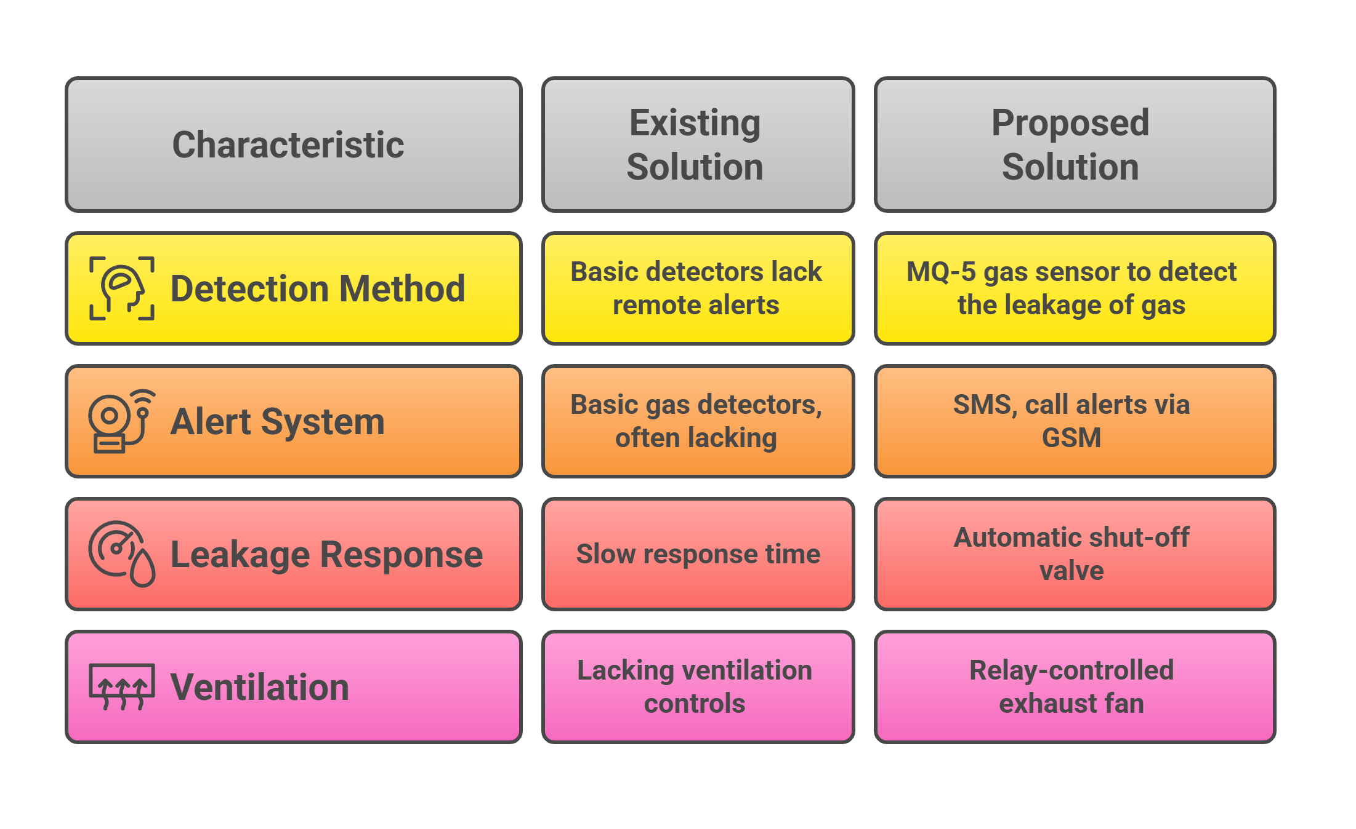
Existing Vs Proposed Solution

Slide 6
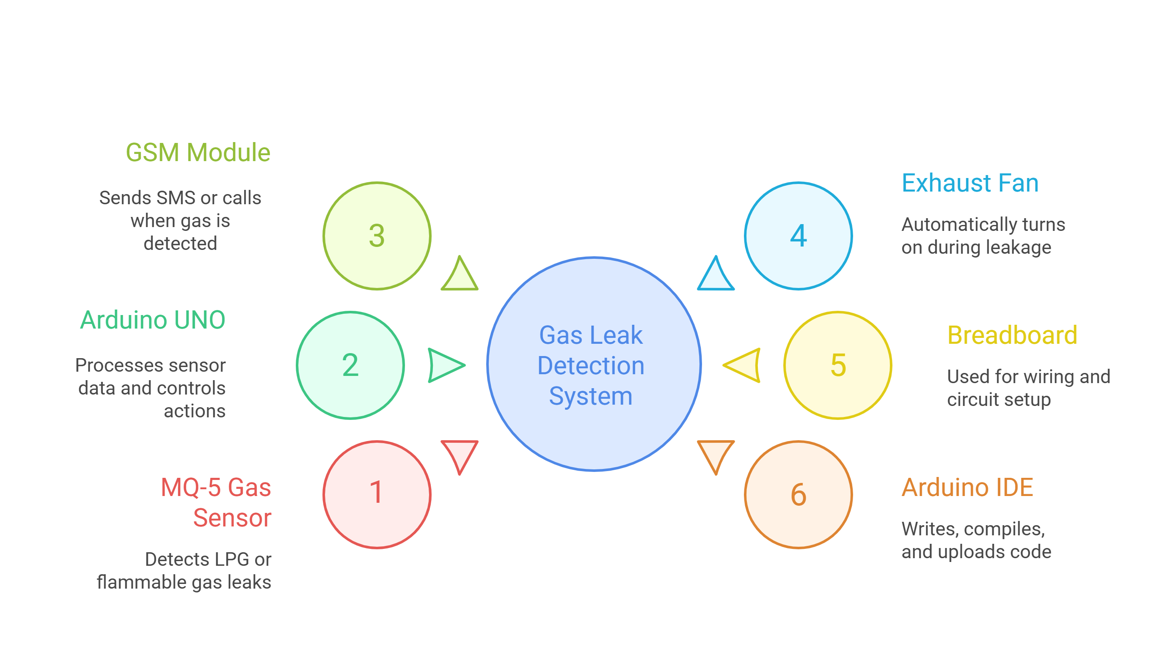
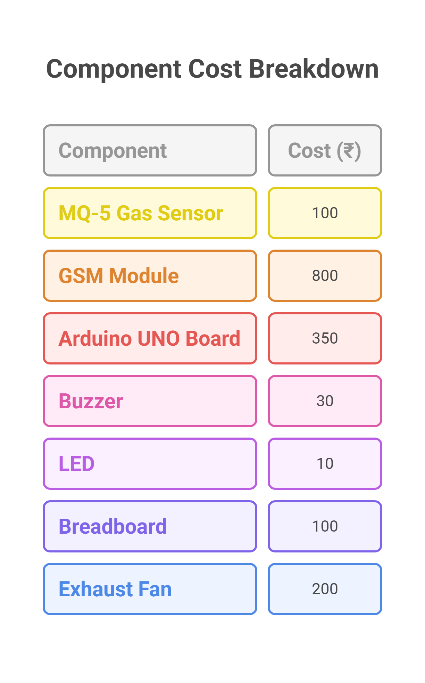
Software / Hardware Tools used

Slide 7
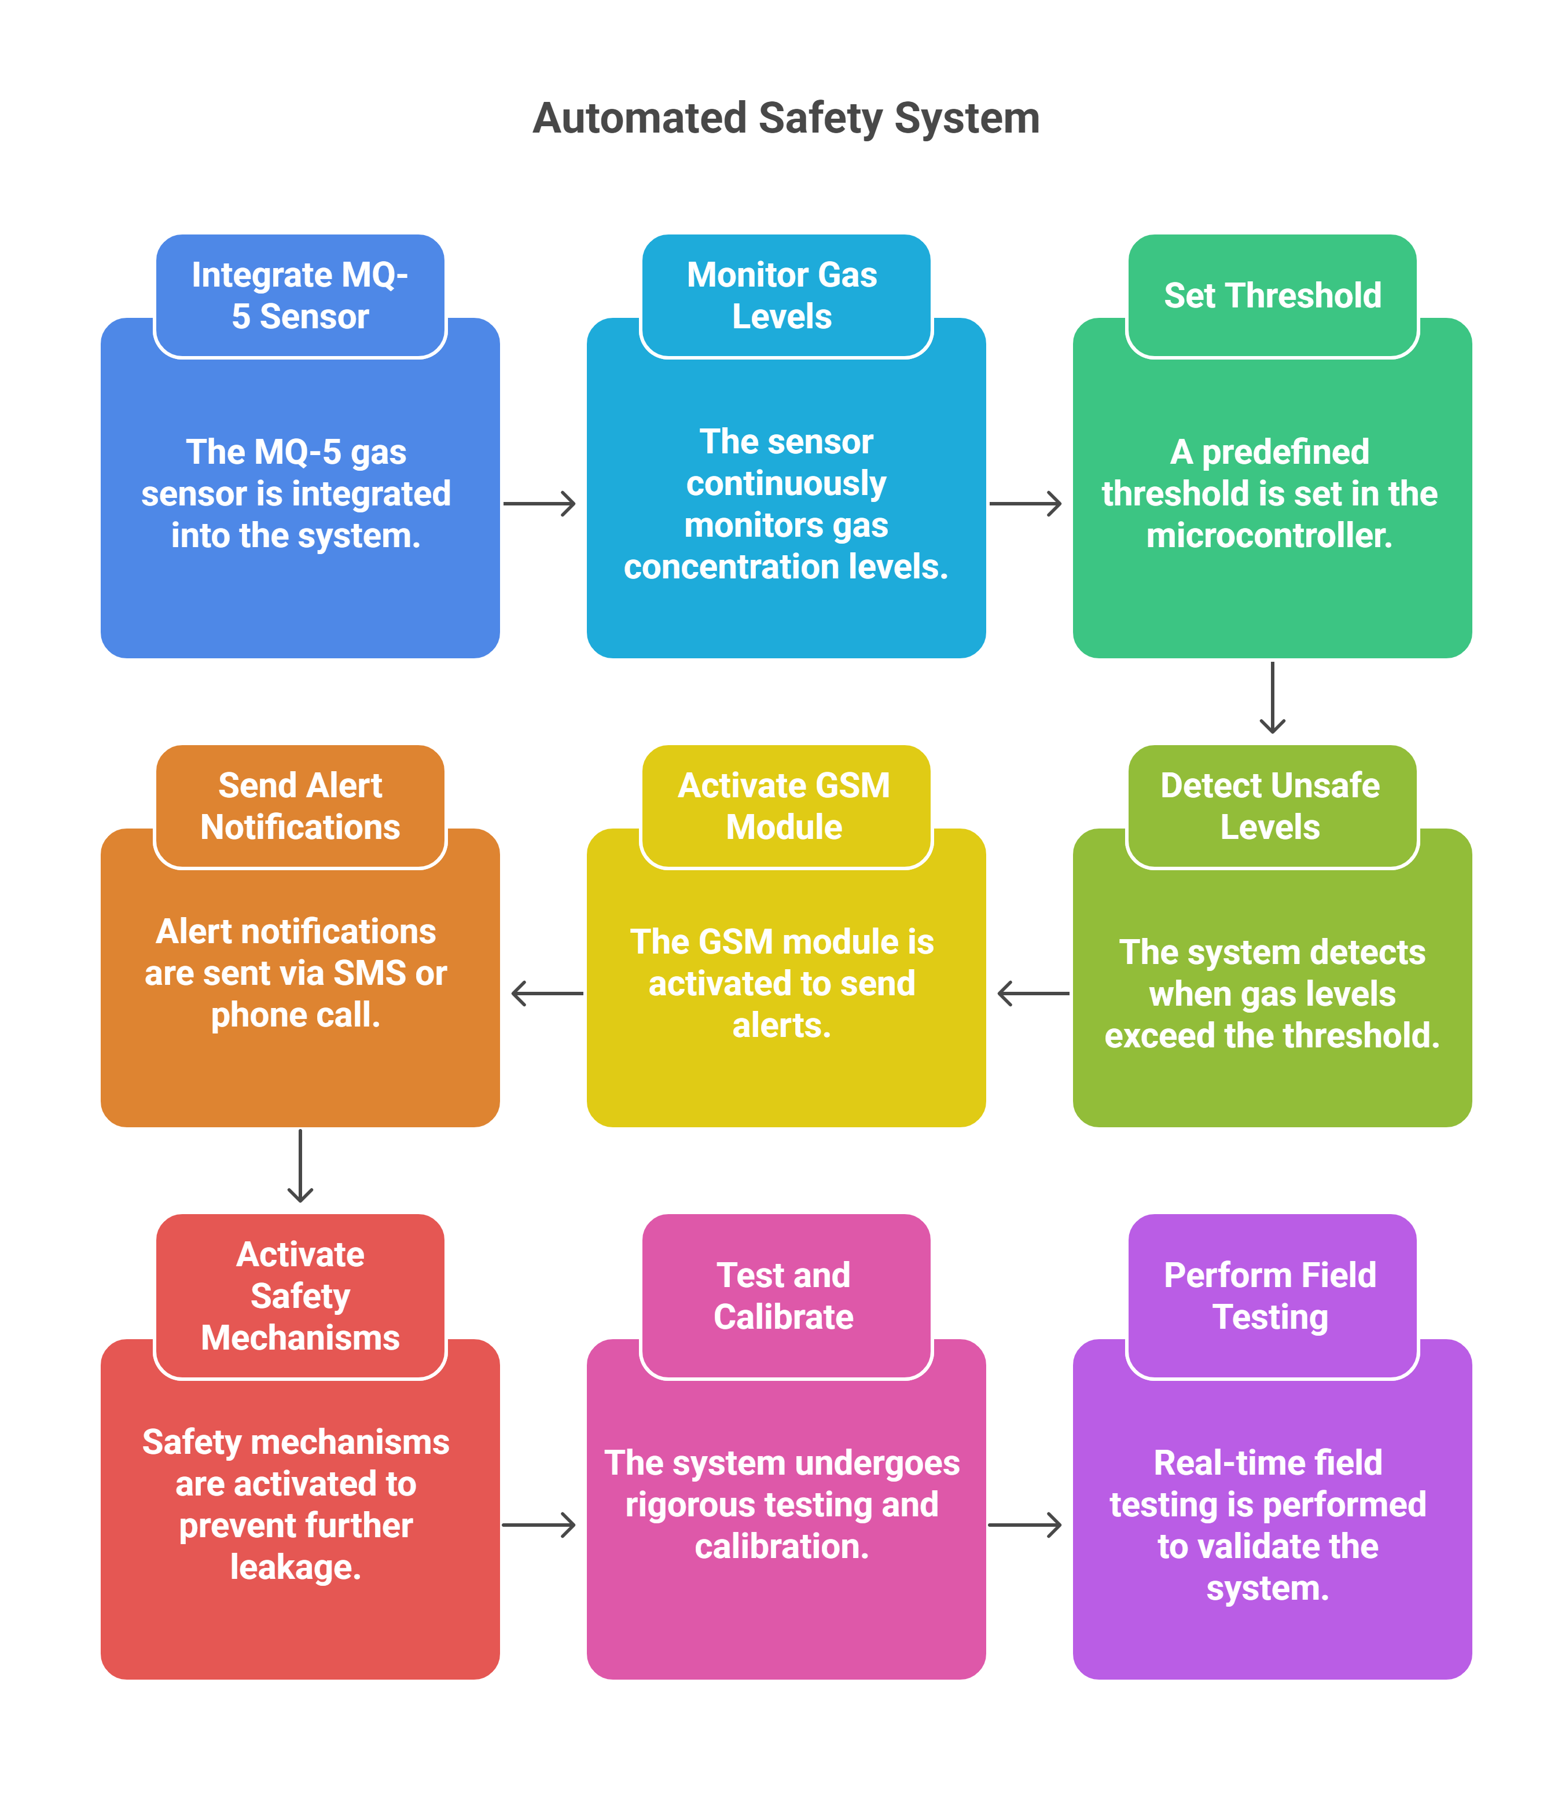
Implementation Details

Slide 8

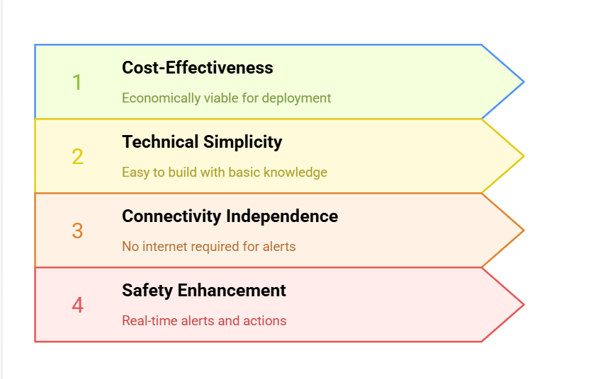

Feasibility

Slide 9
Thank you!

